Slide 1
Group 30
Professor : Prof. Naveen Kumar
Mentor : Pooja Bavishi
Project Team Member:
Ayam Ajmera (1401096)
Charvik Patel (1401079)

Slide 2
Why we Interested in Making Project such as Social Networking ?
To build a social networks or social relations among people who share similar interests, activities, backgrounds or real-life connections.
Social network sites/app are web/network-based services that allow individuals to create a public profile, create a list of users with whom to share connections, and view and cross the connections within the system.
According to the survey they found that 73% of online teenagers use SNS*, which is an increase from 65% in 2008, 55% in 2006,thus there are plenty of user available and to develop an business model.

Slide 3
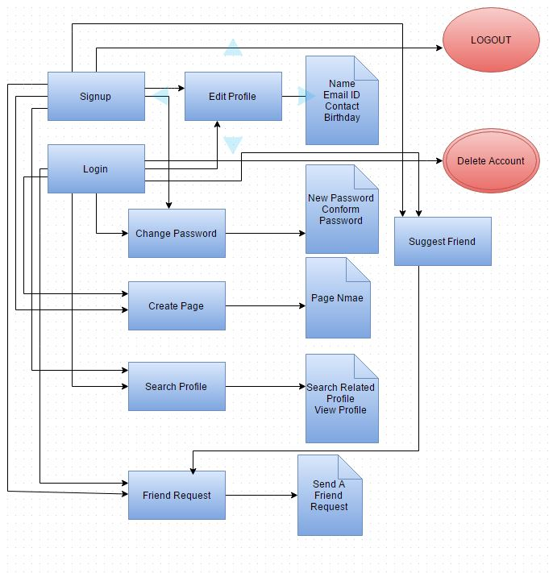
Flow Chart

Slide 4
Features of Our Social networking
Create Profile
Search Profile
Send Friend Request
Add Friend Request By Suggesting From Friend
Create Page
Edit Profile
Change Password
Delete Account

Slide 5
Future Propositions
Chat Over Network using socket programming
Posting an Image by browsing

Slide 6
Acknowledgement
Prof. Naveen Kumar , IET-AU
Pooja Bavishi, M.Tech , IET-AU
Janvi Shah , M.Tech , IET-AU
Kavita Anjaria,T.A, IET-AU
Riddhi Patel , M.Tech , IET-AU

Slide 7
References
Website:
https://en.wikipedia.org/wiki/Social_networking_service

Slide 8
Appendix
SNS=Social networking site

